Slide 1
Deep Convolutional GAN
for Chest X-Ray Classification
GAN-Based Data Augmentation | 2 Experiments | Pneumonia Detection
Sakina Saifuddin | ANN Project 2

Slide 2
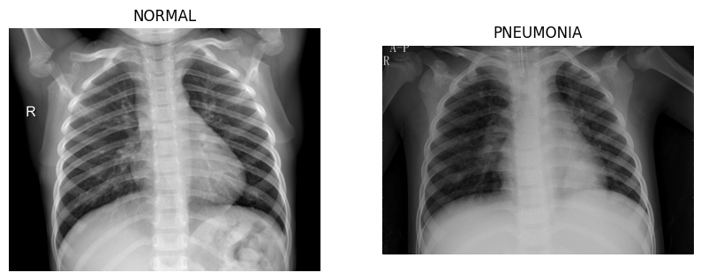
Dataset & Problem Statement
Chest X-Ray Dataset
Split | NORMAL | PNEUMONIA
Train | 1,342 | 3,876
Val | 8 | 8
Test | 234 | 390
Total Training Images: 5,218
Classes: 2 (NORMAL / PNEUMONIA)
Image Size: 64 × 64 px, Grayscale
CNN Batch Size: 64 (Exp 2)
CNN Learning Rate: 0.001 → 0.0001
Class Imbalance: 3,876 Pneumonia vs 1,342 Normal → Main reason augmentation is needed

Slide 3
Architecture Overview
Baseline CNN
GAN – Generator
GAN – Discriminator
• 3 × Conv2D (16 → 32 → 64 filters)
• Input: Random noise z ∈ ℝ¹⁰⁰
• Input: 64×64 grayscale image
• MaxPool after each conv layer
• 5 × ConvTranspose2D layers
• 4 × Conv2D layers (32→64→128→256)
• Dropout = 0.5 (added in Exp 2)
• BatchNorm + ReLU activations
• LeakyReLU slope = 0.2
• FC: 4096 → 128 → 2 classes
• Output: 64×64 image (Tanh)
• Output: Real / Fake (Sigmoid)
Loss: CrossEntropyLoss (CNN) | BCELoss (GAN) | Optimizer: Adam | LR: 0.001 (CNN) / 0.0002 (GAN)

Slide 4
Parameter Variation — Experiment 1 vs Experiment 2
Parameter | Experiment 1 (Original) | Experiment 2 (Improved)
GAN Training Epochs | 20 | 50
GAN Batch Size | 64 | 32
GAN Learning Rate | 0.0002 | 0.0002 (kept same)
Latent Dimension z | 100 | 100 (kept same)
Synthetic Images Generated | 500 | 2,000
Added To Class | PNEUMONIA ❌ | NORMAL ✅
CNN Epochs | 5 | 10
CNN Batch Size | 32 | 64
CNN Learning Rate | 0.001 | 0.0001
Dropout | None | 0.5
Class Weights | None | Normal × 3.0
Data Augmentation | None | Flip + Rotation 10°

Slide 5
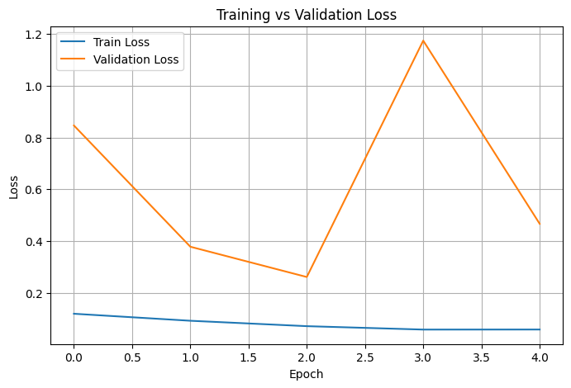
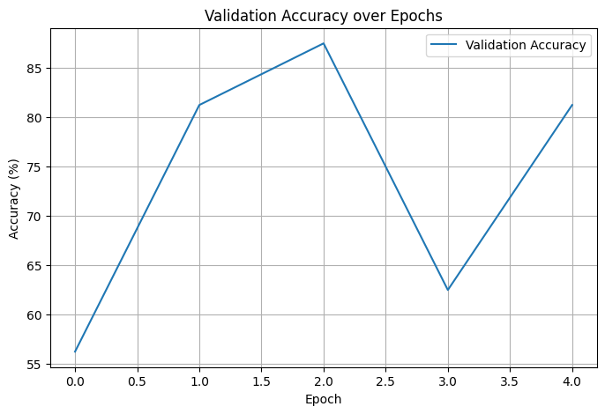
Experiment 1 — Baseline CNN (5 Epochs, LR 0.001, Batch 32)
82.85%
0.0575
87.50%
0.98
0.57
Test Accuracy
Final Train Loss
Peak Val Accuracy
Pneumonia Recall
Normal Recall
Train Loss: 0.1130 → 0.0575 | Val Accuracy: 50% – 87.5% | Val loss very unstable

Slide 6
Experiment 1 — Baseline CNN Confusion Matrix & Report
Confusion Matrix
Classification Report
Class | Precision | Recall | F1
NORMAL | 0.95 | 0.57 | 0.71
PNEUMONIA | 0.79 | 0.98 | 0.88
Accuracy |  |  | 82.85%
Macro Avg | 0.87 | 0.78 | 0.79
134
100
Correct Normal
Normal → Pneumonia
7
383
Normal recall = 0.57 → 100 normal cases missed Pneumonia recall = 0.98 → model biased to pneumonia Test Accuracy: 82.85%
Pneumonia → Normal
Correct Pneumonia
Predicted →

Slide 7
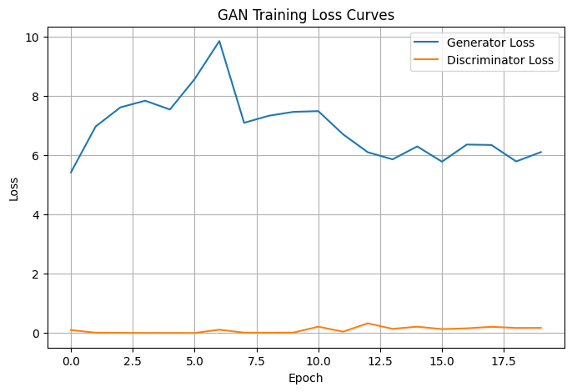
Experiment 1 — GAN Training (20 Epochs)
GAN Config — Exp 1
Epochs: 20
Batch Size: 64
LR: 0.0002
Latent z: 100
Images Saved: 500
Added To: PNEUMONIA ❌
Loss: BCELoss
G Loss ~6–10 | D Loss near 0 → Discriminator dominated → Noisy images generated

Slide 8
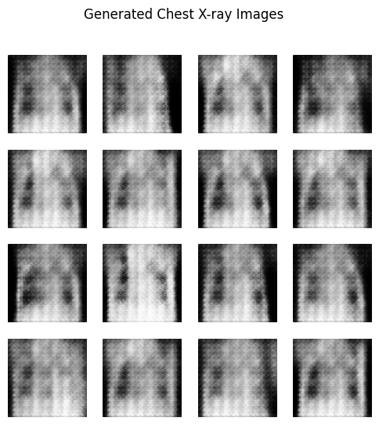
Experiment 1 — GAN Generated Images (20 Epochs)
16 Synthetic X-rays from GAN trained for 20 epochs | 64×64 px | Grayscale
⚠ Very noisy — lung structure barely visible
✓ Added 500 fake images → PNEUMONIA class

Slide 9
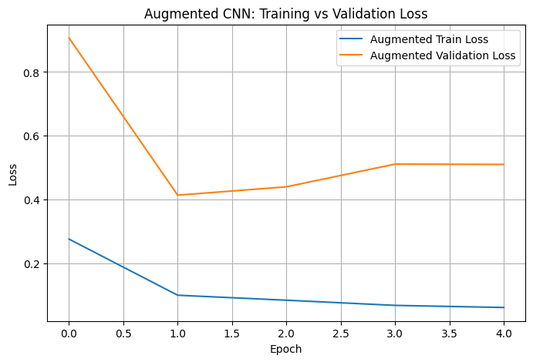
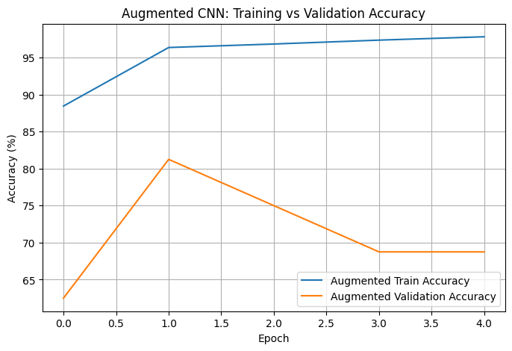
Experiment 1 — Augmented CNN Results (5 Epochs)
75.00%
0.0600
98%
0.99
0.34
Test Accuracy
Final Train Loss
Train Accuracy
Pneumonia Recall
Normal Recall
Train Acc 98% | Val Acc dropped to 69% | Accuracy fell from 82.85% → 75% | Severe overfitting

Slide 10
Experiment 1 — Augmented CNN Confusion Matrix & Report
Augmented Confusion Matrix
Classification Report
Class | Precision | Recall | F1
NORMAL | 0.96 | 0.34 | 0.51
PNEUMONIA | 0.72 | 0.99 | 0.83
Accuracy |  |  | 75.00%
Macro Avg | 0.84 | 0.67 | 0.67
80
154
Correct Normal
Normal → Pneumonia
3
387
Normal recall dropped: 0.57 → 0.34 154 normal cases wrongly called pneumonia Fake images added to PNEUMONIA → worsened imbalance 5,216 → 5,716 images | Accuracy: 82.85% → 75%
Pneumonia → Normal
Correct Pneumonia
Predicted →

Slide 11
What Went Wrong in Exp 1 → Changes Made for Exp 2
✗
Added 500 fake images to PNEUMONIA class
✓
Added 2,000 fake images to NORMAL class
✗
GAN only trained for 20 epochs → noisy images
✓
Increased GAN to 50 epochs → clearer images
✗
CNN trained for 5 epochs — not enough
✓
Increased CNN to 10 epochs
✗
No class weights — model ignored NORMAL
✓
Added class weights: Normal × 3.0
✗
No Dropout — model memorized training data
✓
Added Dropout = 0.5 to reduce overfitting
✗
Learning rate 0.001 — val loss jumping wildly
✓
Reduced CNN LR to 0.0001 for stability

Slide 12
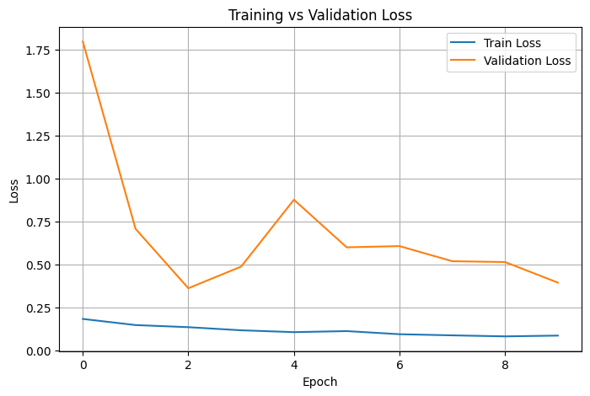
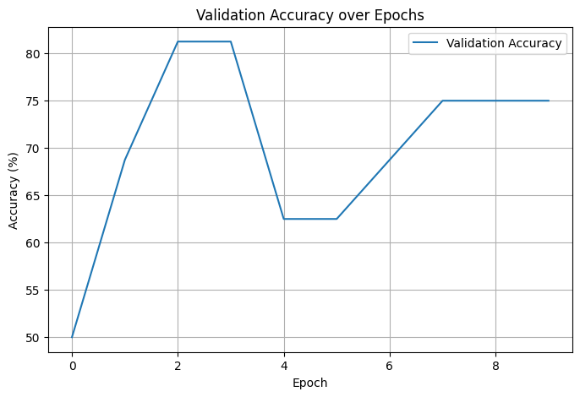
Experiment 2 — Baseline CNN (10 Epochs, LR 0.001, Batch 64, Dropout 0.5)
73.56%
0.0865
81.25%
0.99
0.32
Test Accuracy
Final Train Loss
Peak Val Accuracy
Pneumonia Recall
Normal Recall
Train Loss: 0.1834 → 0.0865 | Val Accuracy: 50% → 75% | More stable than Exp 1

Slide 13
Experiment 2 — Baseline CNN Confusion Matrix & Report
Confusion Matrix
Classification Report
Class | Precision | Recall | F1
NORMAL | 0.97 | 0.32 | 0.48
PNEUMONIA | 0.71 | 0.99 | 0.83
Accuracy |  |  | 73.56%
Macro Avg | 0.84 | 0.65 | 0.65
74
160
Correct Normal
Normal → Pneumonia
2
388
Normal recall = 0.32 → 160 normal cases missed Still biased toward pneumonia — class imbalance effect This baseline will be improved by augmentation in Exp 2
Pneumonia → Normal
Correct Pneumonia
Predicted →

Slide 14
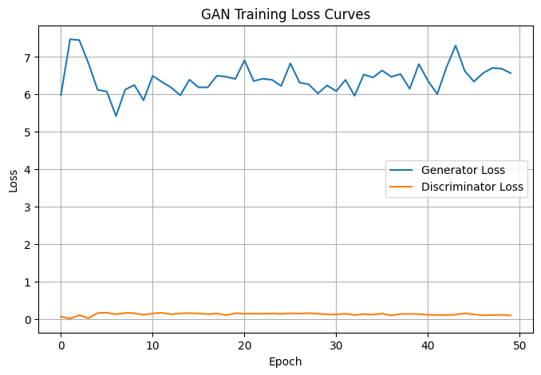
Experiment 2 — GAN Training (50 Epochs)
GAN Config — Exp 2
Epochs: 50
Batch Size: 32
LR: 0.0002
Latent z: 100
Images Saved: 2,000
Added To: NORMAL ✅
Loss: BCELoss
G Loss stabilized ~6–7 | D Loss near 0 | 50 epochs = much better image quality

Slide 15
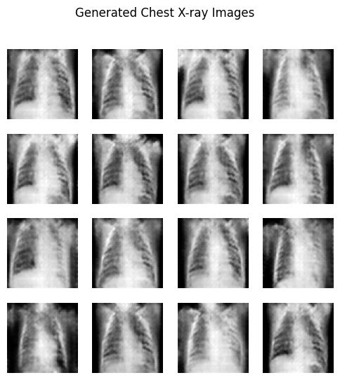
GAN Generated Images — 20 Epochs vs 50 Epochs
Experiment 1 — 20 Epochs
Experiment 2 — 50 Epochs
Noisy | No clear lung structure | 500 images
Clear lung shape | Chest structure visible | 2,000 images

Slide 16
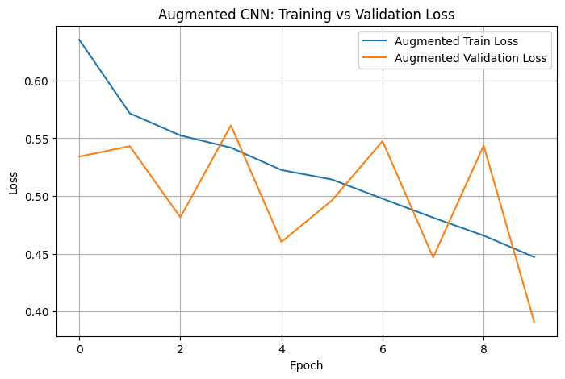
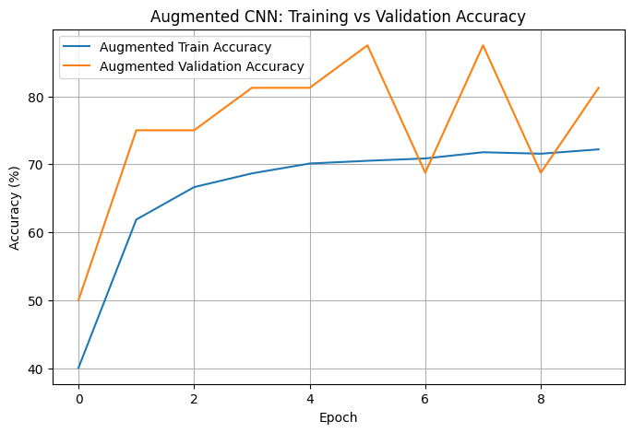
Experiment 2 — Augmented CNN Results (10 Epochs, LR 0.0001, Class Weights)
82.21%
0.4471
87.50%
0.87
0.76
Test Accuracy
Final Train Loss
Peak Val Accuracy
Pneumonia Recall
Normal Recall
Train Loss: 0.6354 → 0.4471 | Val Accuracy peaked 87.5% | Train & Val both improving — less overfitting

Slide 17
Experiment 2 — Augmented CNN Confusion Matrix & Report
Augmented Confusion Matrix
Classification Report
Class | Precision | Recall | F1
NORMAL | 0.79 | 0.76 | 0.77
PNEUMONIA | 0.86 | 0.87 | 0.87
Accuracy |  |  | 82.21%
Macro F1 |  |  | 0.82
179
55
Correct Normal
Normal → Pneumonia
49
341
Normal recall jumped: 0.32 → 0.76 ✅ Model now identifies normal cases much better Dataset: 1,342+2,000=3,342 Normal | 3,876+2,000=5,876 Pneumonia Total training images: 9,218 | Accuracy: 73.56% → 82.21% ✅
Pneumonia → Normal
Correct Pneumonia
Predicted →

Slide 18
Full Comparison — All 3 Models Across Both Experiments
Metric | Exp 1 Baseline | Exp 1 Augmented | Exp 2 Baseline | Exp 2 Augmented ✅
Test Accuracy | 82.85% | 75.00% | 73.56% | 82.21%
Training Images | 5,216 | 5,716 | 5,218 | 9,218
CNN Epochs | 5 | 5 | 10 | 10
GAN Epochs | — | 20 | — | 50
Normal Recall | 0.57 | 0.34 | 0.32 | 0.76
Pneumonia Recall | 0.98 | 0.99 | 0.99 | 0.87
F1 – Normal | 0.71 | 0.51 | 0.48 | 0.77
F1 – Pneumonia | 0.88 | 0.83 | 0.83 | 0.87
Macro F1 | 0.79 | 0.67 | 0.65 | 0.82
Overfitting | Moderate | Severe | Low | Low

Slide 19
Visual Comparison — Accuracy & Recall Across All Models

Slide 20
Final Conclusion
1
Exp 1 augmented PNEUMONIA class → accuracy fell 82.85% → 75% | Normal recall dropped to 0.34
2
Exp 2 fixed the class: added 2,000 images to NORMAL → balanced dataset (3,342 vs 5,876)
3
50 GAN epochs produced clearer chest images vs 20 epochs (visible lung structures)
4
Dropout + Class Weights + LR 0.0001 → reduced overfitting significantly in Exp 2
5
Exp 2 augmented model: accuracy 82.21% | Normal recall 0.76 | Macro F1 = 0.82
→
Future work: Conditional GAN (cGAN) — generate class-specific images for even better balance

